Slide 1
Computers & Society
Hyland Hy-Tech Camp

Slide 2
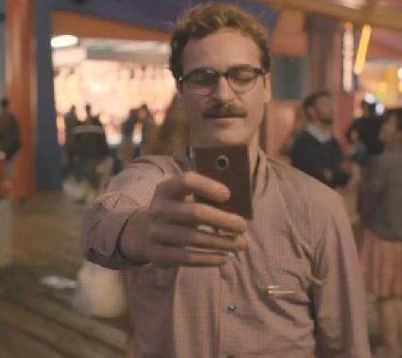
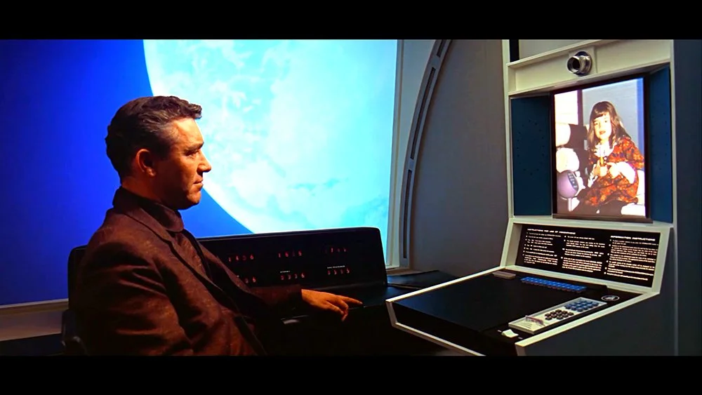
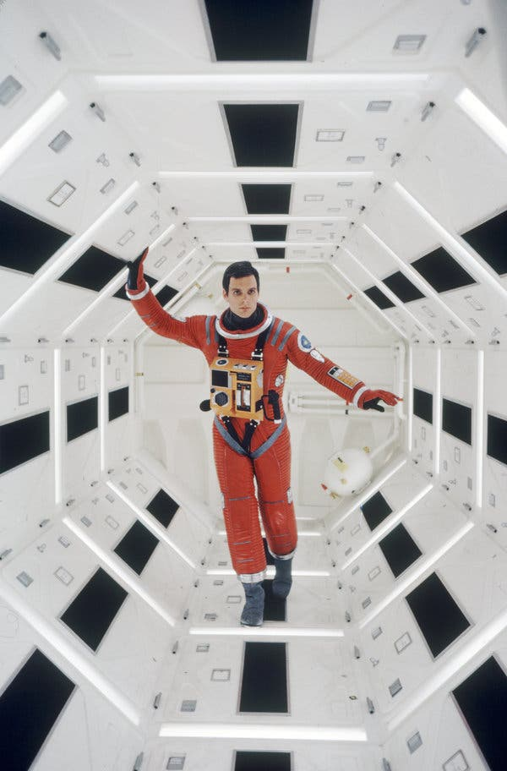
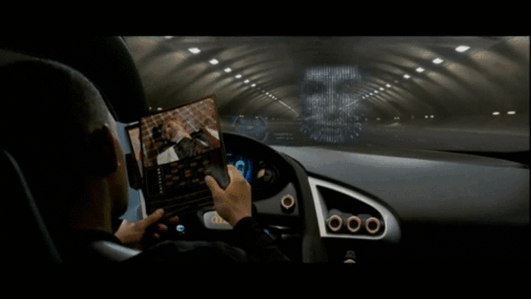
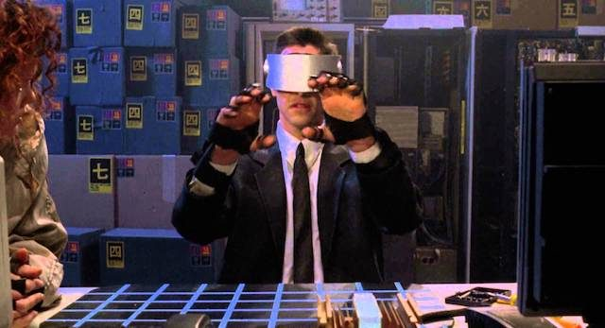
Science Fiction v. Science Itself
Notes:
Ask the students to give examples of science fiction
Note that some ideas that were once science fiction have become a reality:
Video Calls
Self-Driving Cars
A.I. Powered Voice Assistants
Virtual Reality
Space Stations
Ask the students if they recognize where any of these originate:
Video Calls + Space Station – 2001: A Space Odyssey
Self-Driving Cars – I, Robot
A.I. Powered Voice Assistant – Her
Virtual Reality – Johnny Mnemonic
Note that we will explore the impact of these technologies in this presentation

Slide 3
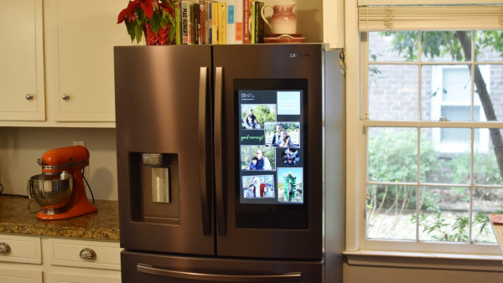
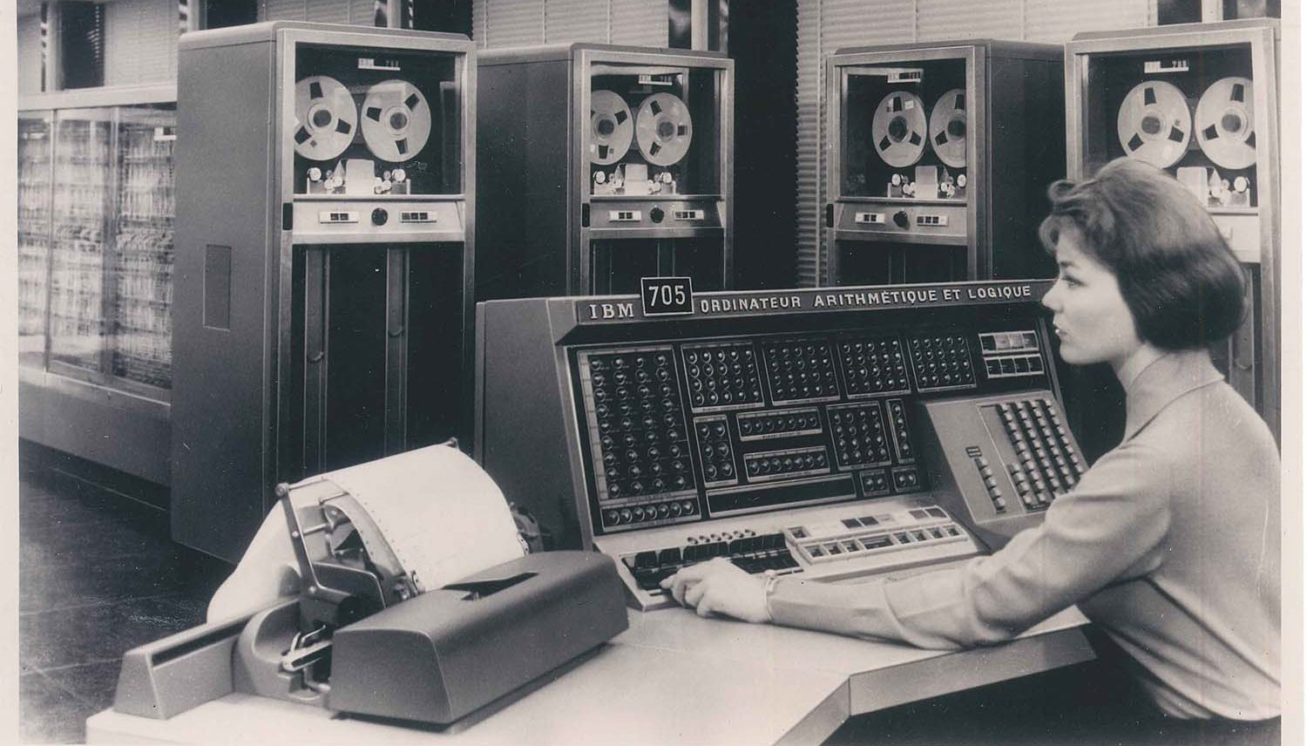
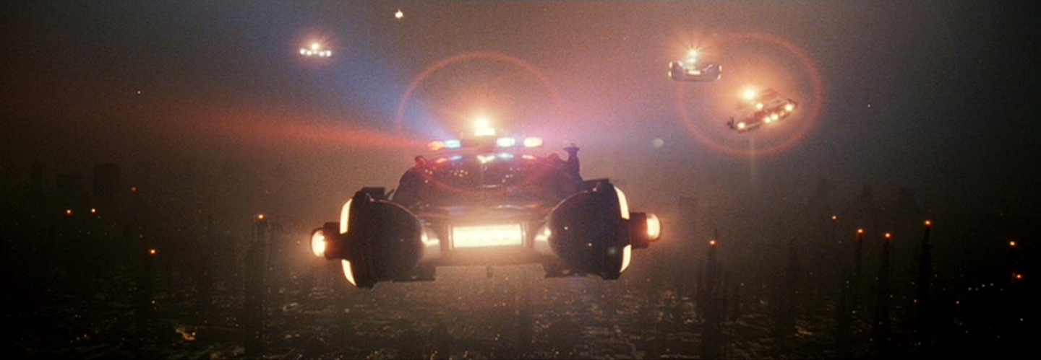
Camp Agenda
Past
How did we get here?
How have computers and other technologies had an impact on society throughout history?
Present
Where are we exactly?
What computer technologies are currently having an impact on society?
Future
Where are we going?
How will emerging technologies enter the mainstream?
What hypothetical technologies could become a reality?
Notes:
Go through the basic sections this presentation will contain
Make sure to note that this camp will only scratch the surface of the history, present day, and potential future of computing technology
We will start with the past – note how far we have come since the early days of computers
We will then move onto the present – we will discuss current technologies and how they are changing things in the world (like having tv screens on fridges)
Then, we will look forward to the future – maybe we will end up living in a dystopia like in Blade Runner (but maybe not)

Slide 4
in History
Computers
How have computers had an impact on us?
Notes:
We will begin by discussing some (keyword: some) of the history of computers

Slide 5
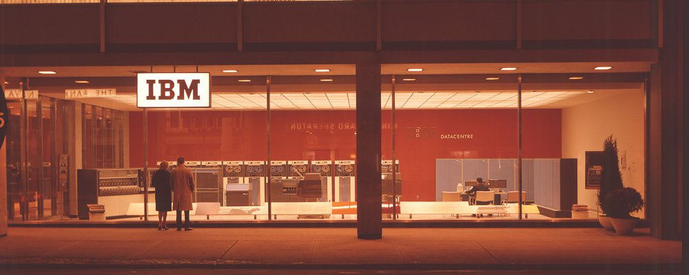
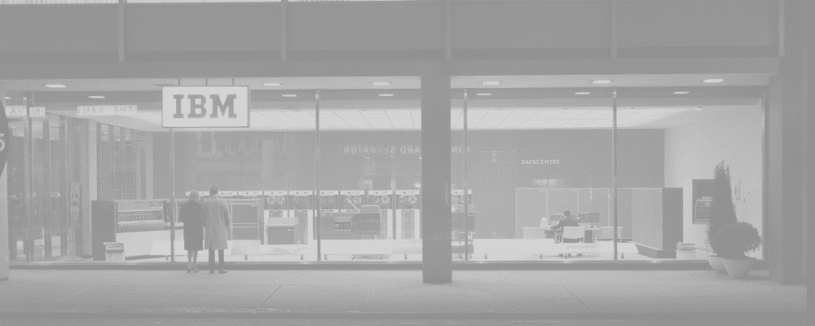
Early Days of
Computers
Giant, complex calculators for science
Various military and academic applications – research and codebreaking
(A.I.) started to take shape in earnest in the 1950s
Artificial Intelligence
Notes:
No need to spend too long on this slide…
Show the picture of an IBM Data Center, from Toronto 1963
Talk about how originally, computers were basically just giant calculators used for scientific and engineering equations
In the beginning, most applications were for the military (like code-breaking) or for academic studies
In the 1950s, the field of A.I. was born
https://www.computerhistory.org/timeline/computers/

Slide 6
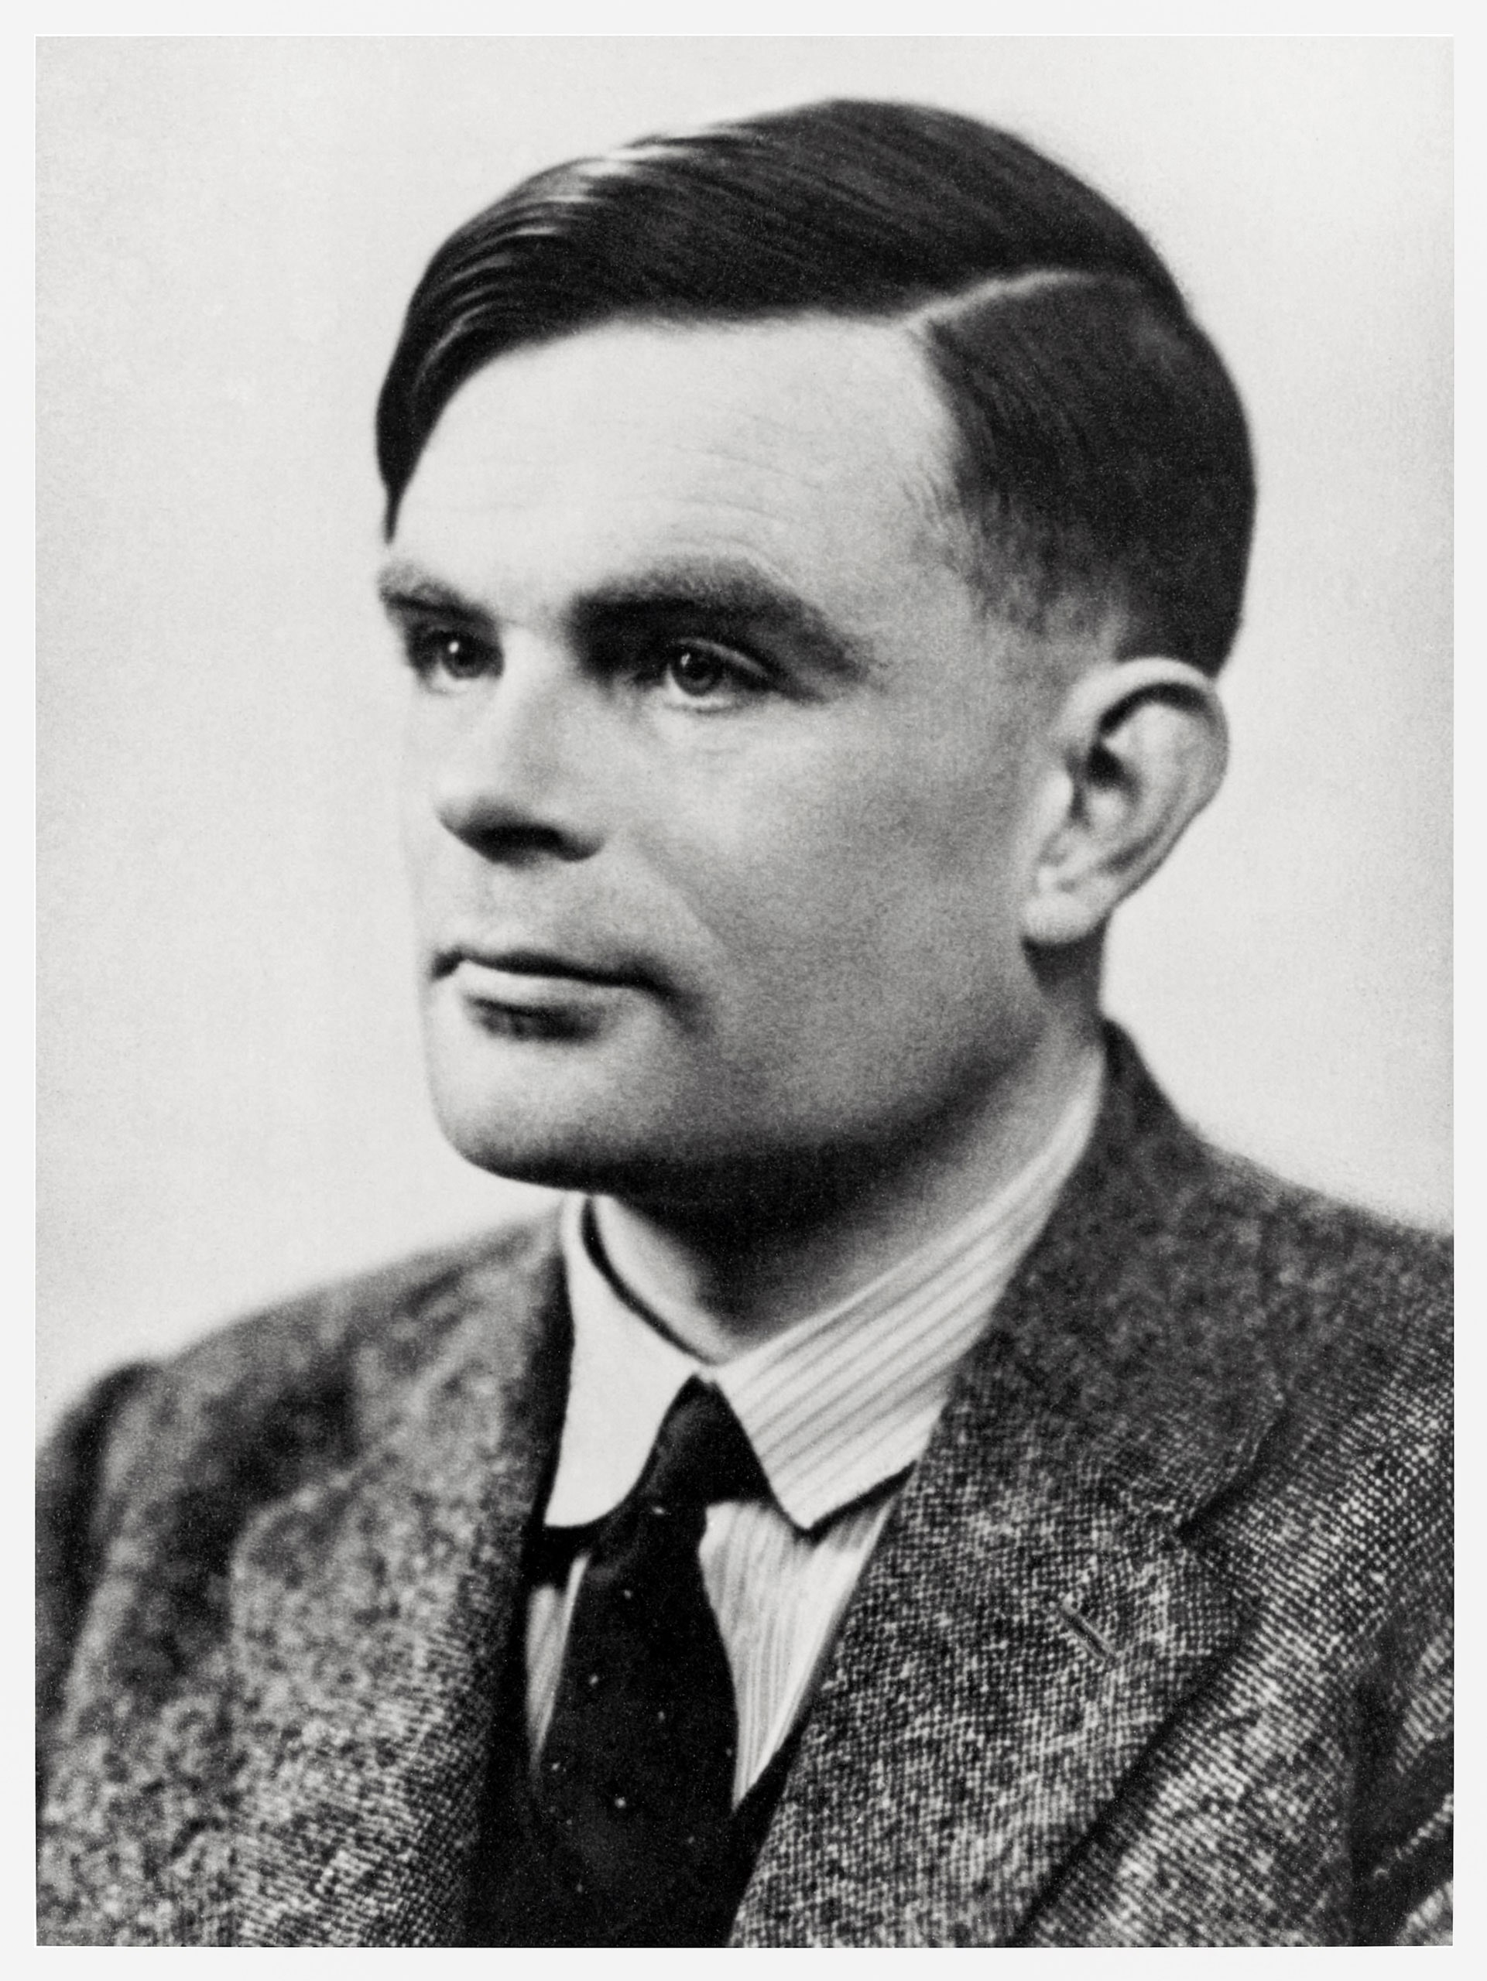

Artificial Intelligence
in History
The Turing Test – can a person tell a computer from a human?
Can a machine actually become conscious?
Will an A.I. ever be as intelligent as a human?
Is the human mind a physical thing?
Can a machine think?
Alan Turing
Notes:
Let’s talk about the history of A.I.
Alan Turing was known as the “father of artificial intelligence”
Seriously recommend reading more about him, he is an incredibly impactful and interesting person
One of his contributions to the field was the “Turing Test” – a way to measure how “intelligent” an artificially intelligent agent actually is
This involves a judge having a conversation via text with two “people” – one, a real person, and the other, a computer
If the computer can successfully fool the judge, it has passed the test!
Poll the students with this question: “Can a machine think?”
Have them put up fingers or answer in the Zoom chat:
1 for yes
2 for no
3 for maybe/not sure/depends
Poll the students in the same way with the following questions
Can a machine actually become conscious?
Will an A.I. ever be as intelligent as a human?
In this case, it means generally intelligent, i.e., able to solve any problem a human can solve
Is the human mind a physical thing?
https://plato.stanford.edu/entries/turing-test/
https://plato.stanford.edu/entries/chinese-room/

Slide 7
Practical Applications
Through the 40s, 50s and 60s, computers evolved into general-purpose machines that became commercially available
They were used in business to automate tasks, manage data, and produce reports.
"There is no reason anyone would want a computer in their home.“
Ken Olson
1977
Notes:
No need to spend too long on this slide…
Now let’s move away from the philosophical and into the practical. How were computers actually used in this era?
Talk about the evolution of computers – they started being used more widely. Still mostly academic and military
Big business also started adopting the use of computers though, for a variety of purposes
Still, at this time, computers were only really used by researchers or highly technical people in specific fields… they were not commercially available to the general public. To sum that up, show the quote from Ken Olson
Note, it’s kind of apocryphal, even though he did really say it: https://www.snopes.com/fact-check/ken-olsen/
Smash cut to…
https://www.computerhistory.org/timeline/computers/

Slide 8
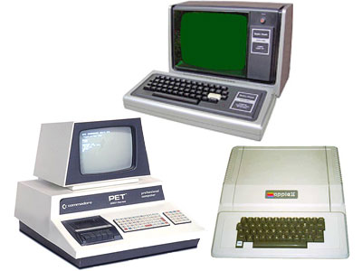
– The Personal Computer
1977
What’s Changed?
Original “PC” Functions
Primitive video games
Word processing
Spreadsheets
Data access/storage
Education
Graphics and Animations
Music composition
General programming
Notes:
No need to spend too long on this slide, other than the discussion portion
The year: 1977
Three very important computers were released this year, that would be dubbed the “Trinity”
Commodore PET (students probably won’t recognize this company)
Apple II (students should recognize this company)
TRS-80 (students might recognize Radio Shack?)
These three computers were the first successful mass-market personal computers – they were “affordable” and “usable”
What could they do? (Ask the students if they have any ideas)
Show some of their functions
Basic video games (with minimal graphics)
Word processing – very primitive version of something like Microsoft Word
Spreadsheets like Microsoft Excel
Database applications
Used to teach students about computers and programming
Could create graphics and animations
Could be used to compose music
Could be used for general programming – there was a ton of interesting and home-brewed software out there!
After going over some of the basic capabilities, ask students how computers now are different

Slide 9

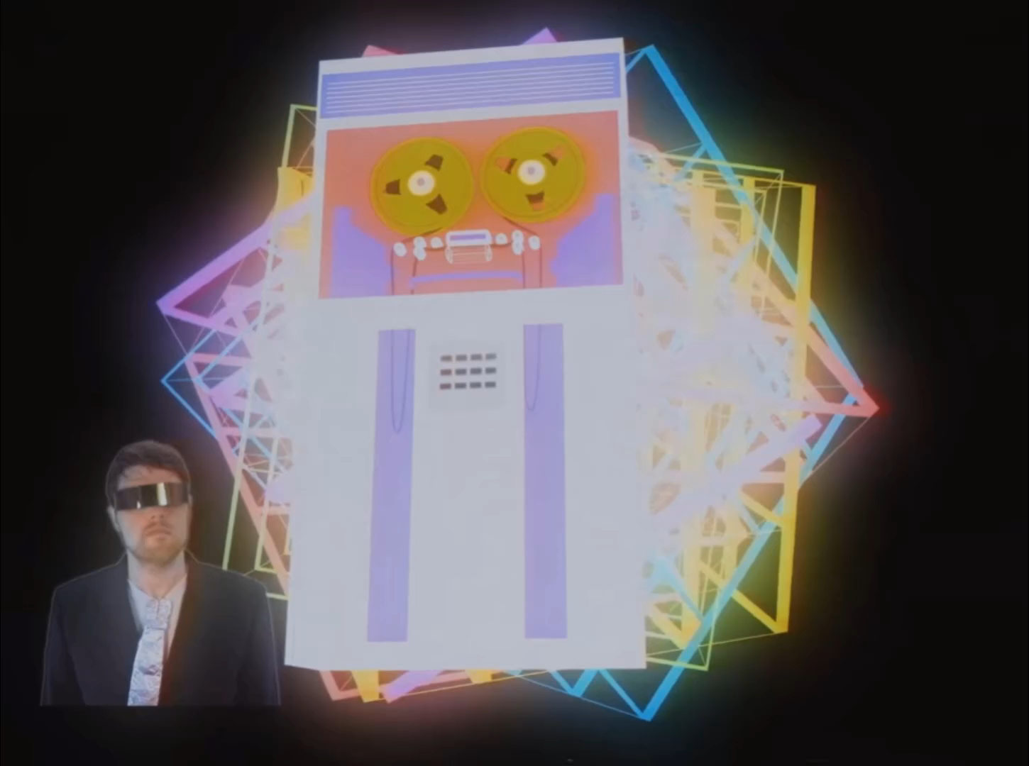



The Internet
(World Wide Web)
Web 1.0
read-only, content created by “admins”
Web 2.0
social web, content created by users
Web 3.0
decentralized web
Notes:
One of the biggest advancements since 1977 is the World Wide Web, or what we know as “The Internet”
Play the video introducing the idea of the internet
Go over Web 1.0 – the first iteration of the web that was “read-only” – content had to be created by those with the means and knowledge to create it. Most users were simply consumers. Mostly static HTML pages rather than dynamic
Go over Web 2.0 – now, pretty much anybody is able to create and share content on the web (Myspace, Twitter). Here, the content was dynamic, the user experience was rich and enveloping, and there was mass participation. It wasn’t only dweebs on the web anymore.
Ask the students if they recognize the logos
Ask the students to name other social media
Briefly touch on Web 3.0 – decentralized ownership of the internet
https://www.youtube.com/watch?v=8We8HChN3a8

Slide 10
The Internet
Good Things
Connections to people
Easier to share things
Remote education
Memes
Streaming TV
Bad Things
Radicalization
Misinformation
Privacy concerns
Crime
Social media addiction
Notes:
Ask the students what positive impacts the internet has had on the world
After a discussion, reveal some examples of “good” things
Ask the students what negative impacts the internet has had on the world
After a discussion, reveal some examples of “bad” things

Slide 11
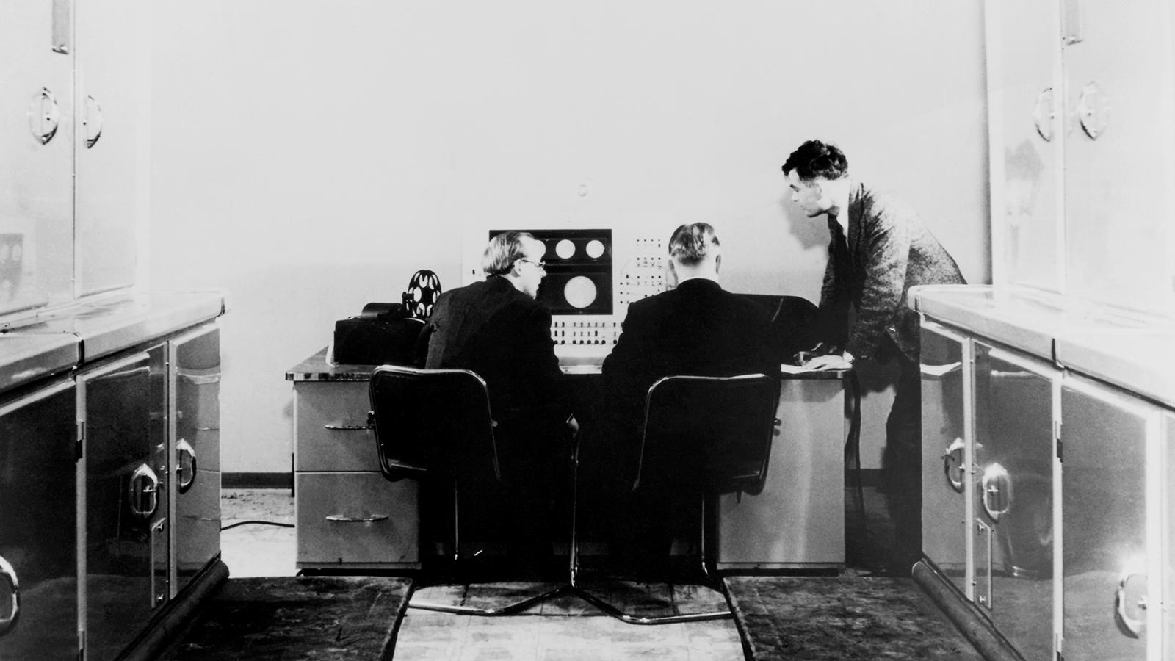
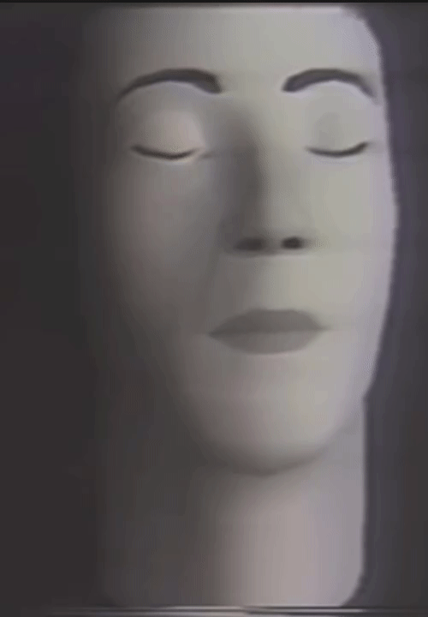

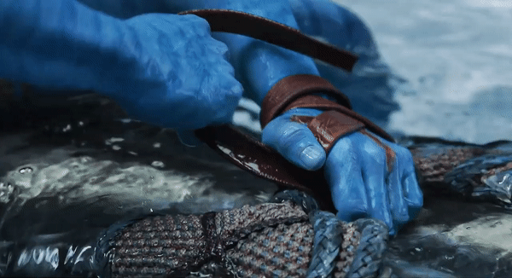
Arts & Entertainment
Electronic Music
Computer-Generated Imagery
from this (1951):
from this (1974):
to this:
to this:
Notes:
Ask the students how computers have impacted arts and entertainment
Show some examples from electronic music
The first recorded instance of computer-generated music – 1951
Fun fact: the computer used to make this music was created by Alan Turing!
60 years later, entire albums can be generated from a computer, like Com Truise – Memory
Most pop music now is created digitally, without any “real” instruments
Show examples of computer-generated imagery
First clip: one of the earliest instances of CGI – from 1974
Second clip: Avatar 2
Entire films are now created using this type of CGI (like the Lion King remake)
https://www.bl.uk/collection-items/earliest-known-recording-of-computer-generated-music
https://comtruise.bandcamp.com/track/memory
https://www.youtube.com/watch?v=SPMFhcC4SvQ
https://twitter.com/boomborks/status/1523993806655614978

Slide 12
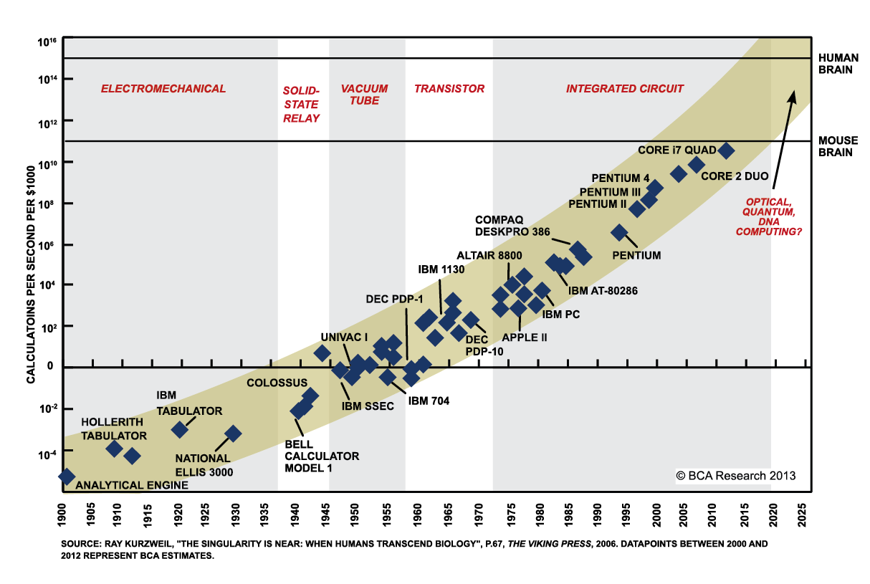
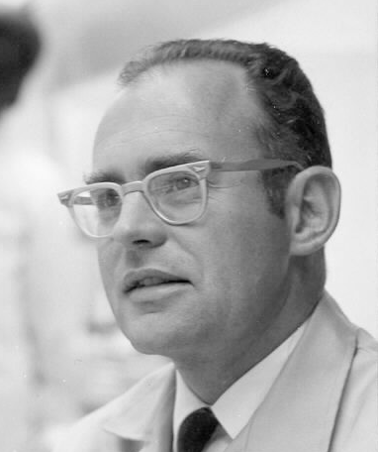
Moore’s Law
“The number of transistors in a dense integrated circuit doubles about every two years”
Gordon Moore in 1965
Notes:
No need to spend too long on this slide…
Show the picture of Gordon Moore in 1965
Reveal his quote – ask the students what they think it means
The main idea is that technology keeps getting better and better, at faster and faster rates
Show the graph just quickly explaining it – things were slow in 1900, but they keep getting faster
This idea can be used in support of the “singularity” – but that’s the future
This leads up to now – after all the years of the past, we have entered the present

Slide 13
in the Present
Computers
How do computers impact us today?
Notes:
We will continue by discussing some (keyword: some) of the ways computers impact the present day

Slide 14
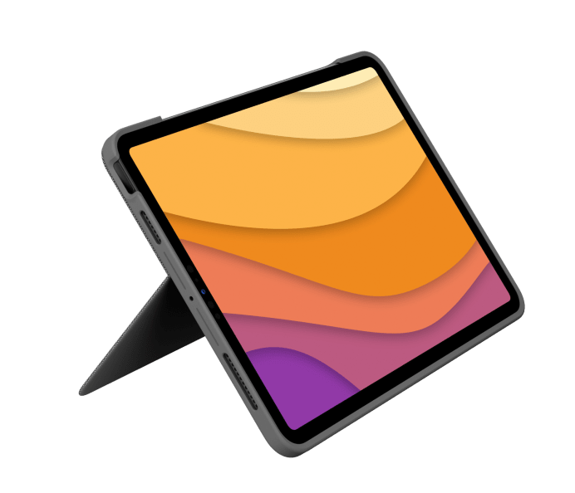
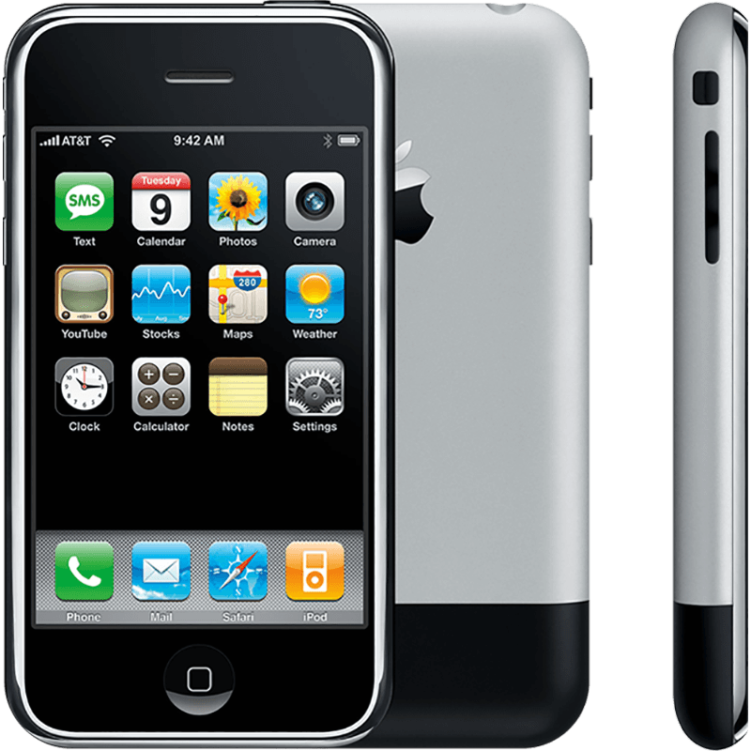
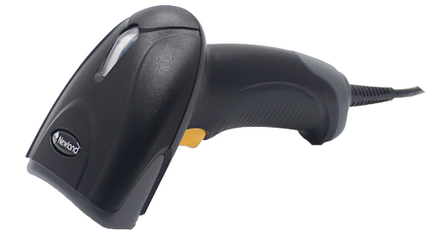
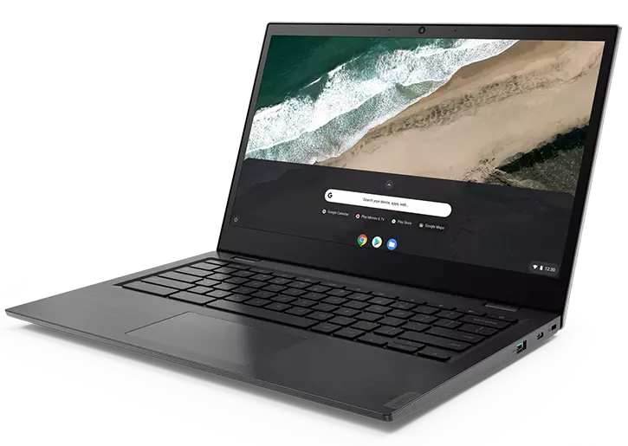
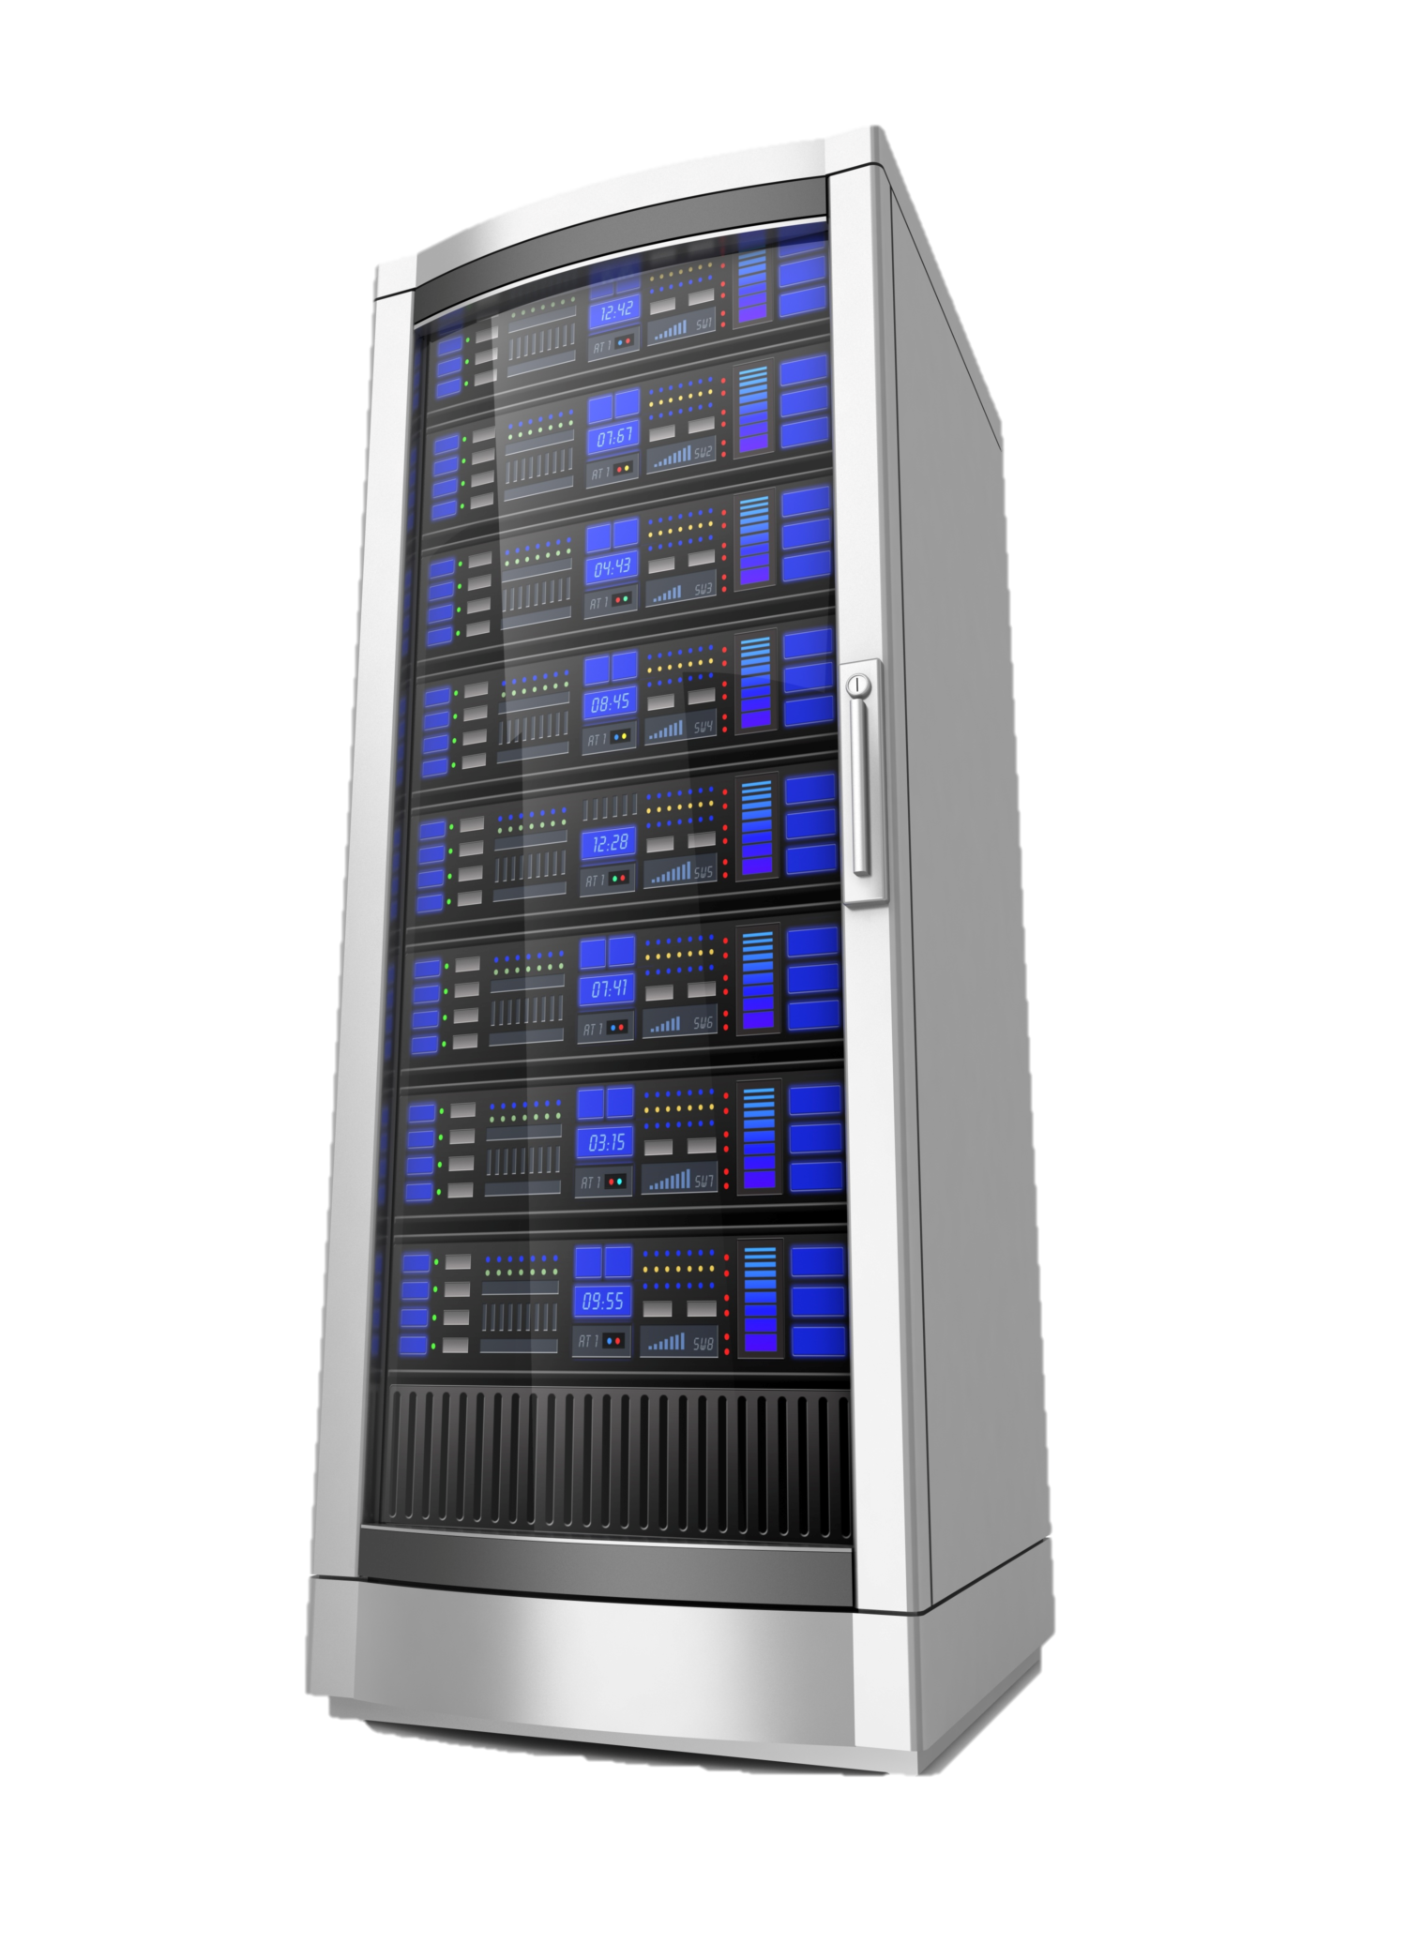

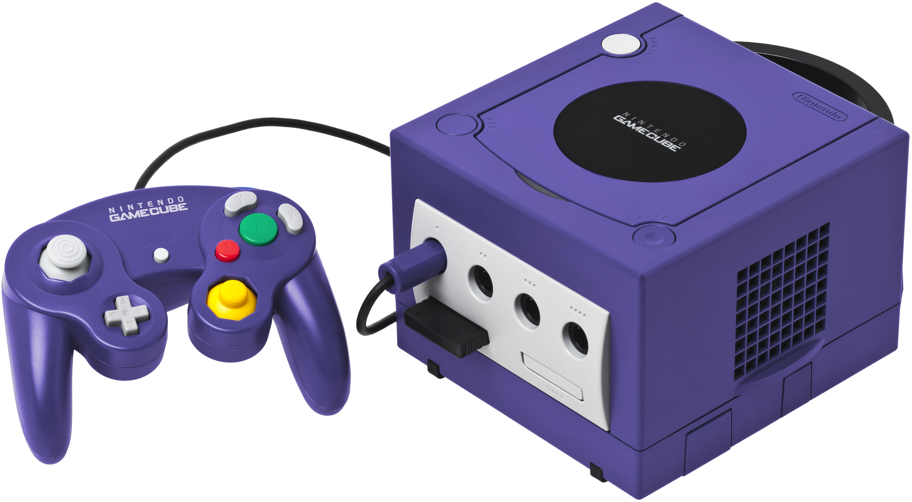
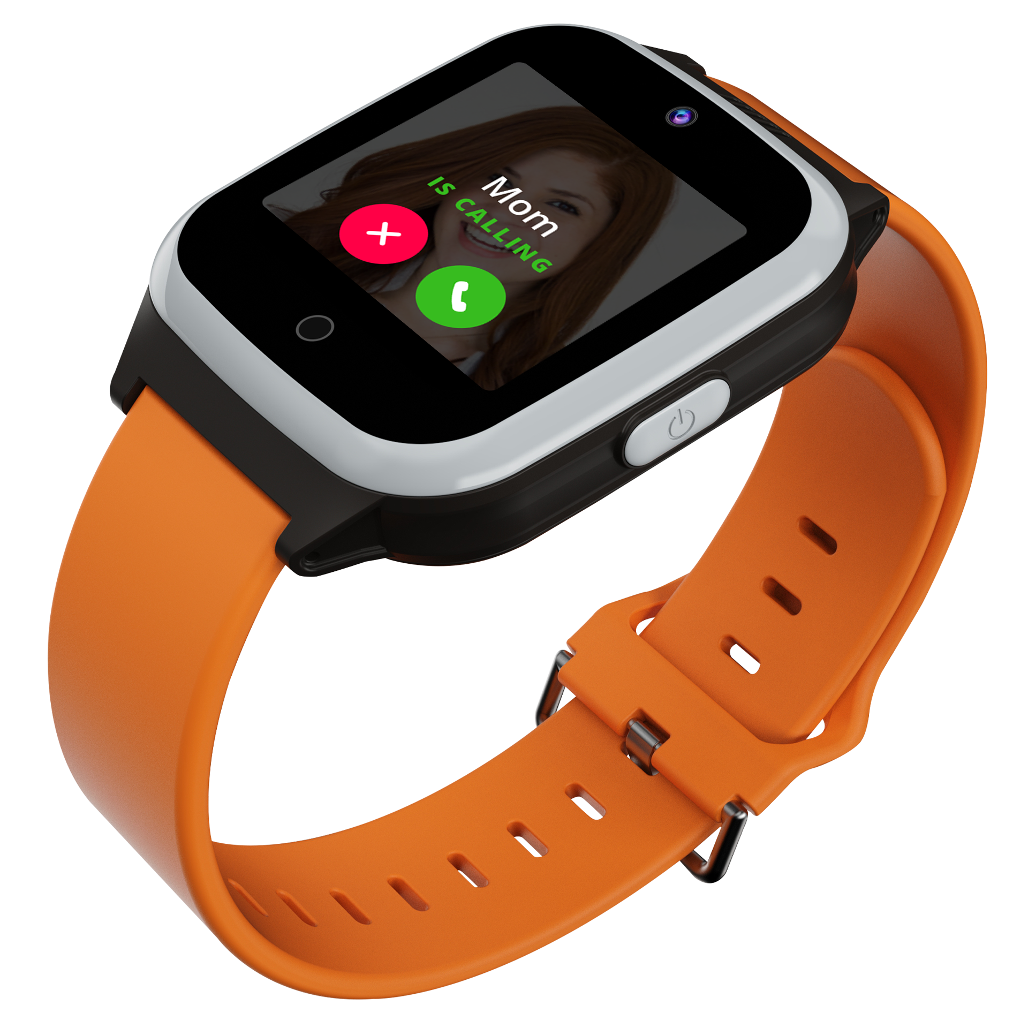
are Everywhere
Computers
What is a computer?
How have smart phones changed the world?
Notes:
Ask the students if they can define a computer
They might think of just a desktop computer, but a computer can be…
A laptop or chromebook
A tablet (like an iPad)
A smart phone (like an iPhone)
A smart watch
A video game console (like a GameCube)
A giant server or data warehouse
A barcode scanner
Ask the students if they know how smart phones have changed the world
The first iPhone (pictured on the slide) is probably older than they are at this point, so they may not know…
Before smart phones, the only real way to access the internet was on a desktop or laptop
Smart phones have helped create an entirely new ecosystem of instantaneous communication

Slide 15


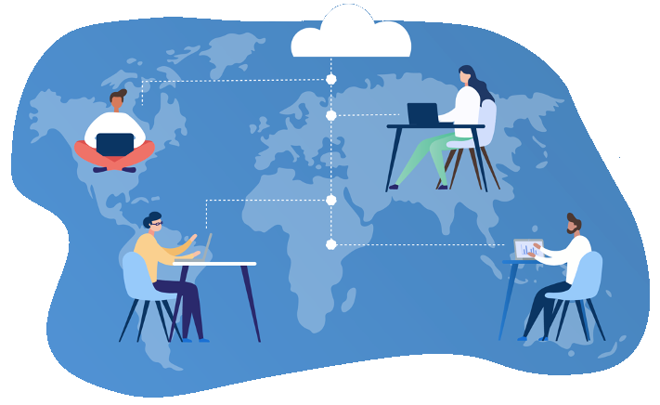
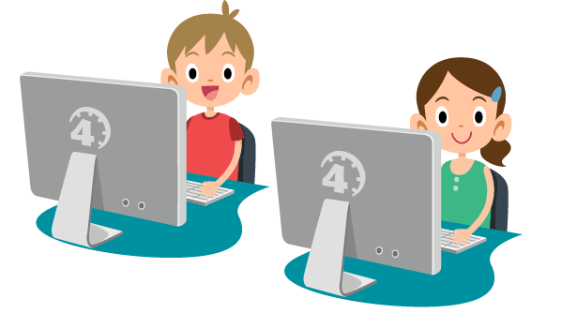

CoViD-19
How did computers affect CoViD-19 lockdowns?
The Digital Divide
The growing gap between people who do not have access to the internet and those who do
How many people across the world
have never used the internet?
What percentage of Cleveland households have no access to the internet (2018)?
2.9bn
27%
Notes:
Ask the students for ways in which computers affected CoViD-19 lockdowns.
Some examples – people were still able to stay in contact via Zoom or Facetime
Not only could families connect, but these tools (along with other software/hardware) also allowed for Remote Learning and Remote Work
However, this didn’t work out well for everyone… ask if anyone has heard of the Digital Divide.
Explain the basic definition of the digital divide – essentially, a lot of people (especially low-income, elderly, and disabled people) do not have access to computers or the internet, while others do
It may be easy to think that everyone has a smart phone, or a home computer, or internet access – but that is far from the truth
CoViD-19 made this divide even more impactful – with “everyone” heading to Zoom, many were left behind
Ask the students to guess how many people across the world have never used the internet
Approximately 2.9 billion people
Think about how this lack of access could affect their lives
Students may be thinking, well that’s just the world, it must be different in the United States…
Ask the students to guess what percentage of Cleveland, OH households have NO internet access (according to a 2018 study)
The answer is a staggering 27%
Ask students why. This generally represents a socio-economic gap, as well as a racial one
Explain that these are just some examples – but the digital divide affects people based on a number of factors
Age
Race
Geography (including rural v. urban)
Income
Ask the students how this digital divide could impact society
Makes education much more difficult – homework gaps, general learning gaps
Uneducated people also tend to have less access – which does not help
Unconnected individuals have far fewer opportunities for things like jobs, community engagement, healthcare – think about everything you use the internet for!
Ultimately, the digital divide is a cycle – without internet, it’s harder to move up in the world, and that makes it harder to get internet
Ask the students how this problem might be solved
Biggest issue is money and infrastructure
Government assistance, corporate partnership, and non-profit/foundation involvement can make a difference
For example, in Cleveland there have been efforts by Cuyahoga County, the Cleveland Foundation, the Gordon Gund Foundation, Verizon, and T-Mobile
https://www.theguardian.com/technology/2021/nov/30/more-than-a-third-of-worlds-population-has-never-used-the-internet-says-un
https://cs.stanford.edu/people/eroberts/cs181/projects/digital-divide/start.html
https://www.pewresearch.org/internet/2021/09/01/the-internet-and-the-pandemic/
https://www.usda.gov/broadband
https://www.clevelandfoundation.org/grants/program-initiatives/digital/
https://www.communitysolutions.com/access-denied-impact-clevelands-digital-divide-students/

Slide 16

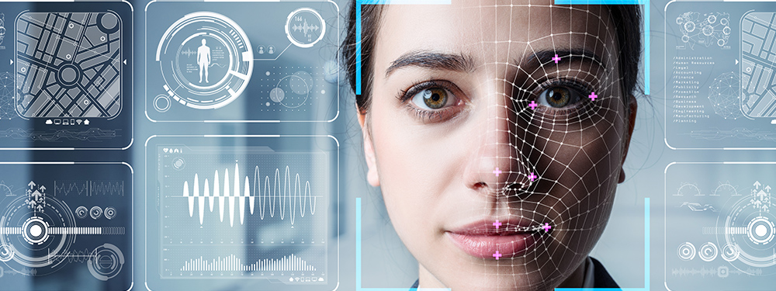
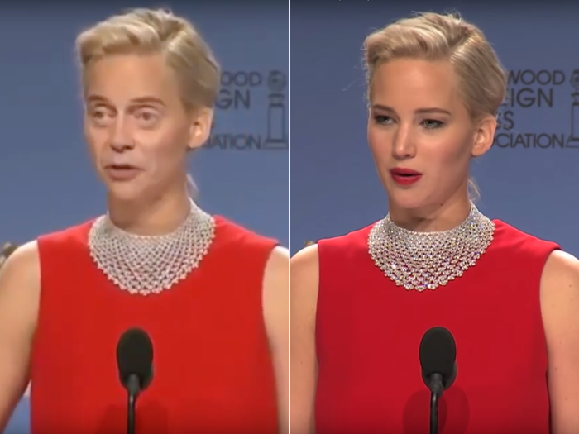
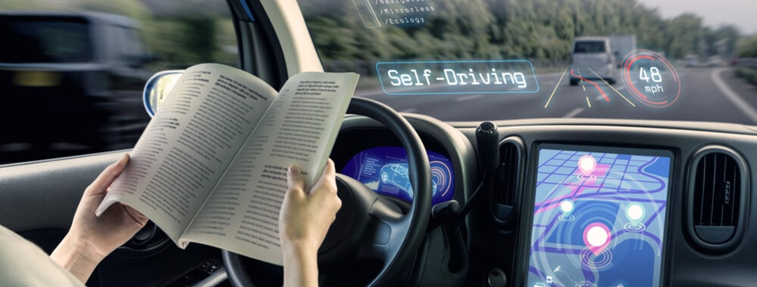
A.I. is Everywhere
Recommendation Engine
Deep learning – neural networks
Different measurements of success
Facial Recognition
TikTok or Snapchat filters
Data theft, algorithmic bias
Deepfakes
Self-Driving Cars
Litigation, job replacement
Notes:
Now let’s get into some specific technologies that are having an impact on the world today.
A.I. is a huge field that has been changing the world in many ways. We will consider just a few of them.
Ask the students if they have ever used YouTube. Ask them how they think YouTube uses A.I.
Reveal that their recommendation engine is powered by A.I.
This is possible because of deep learning & neural networks – we will not explore the technical details
Ask the students how they might measure the success of a recommendation engine
Maybe number of times a video was clicked? Why could that be bad? It could lead to manipulations via clickbait
Maybe length of time watched on the recommended video? But that could lead to saturated long videos
Maybe number of times a recommended video was liked? But maybe people don’t like videos even if they enjoyed them
Ask the students for examples of facial recognition
A big one is TikTok or Snapchat filters (or Instagram or whatever)
iPhone face ID is another one
Go over some of the key concerns with facial recognition
Data theft – big companies or even foreign governments could steal facial data and use it for malicious purposes (such as something we’ll cover later)
Algorithmic bias – imagine if facial recognition was used to identify criminals. Now, imagine the algorithm was only trained on white people, and can’t recognize people of other races... This could be a serious issue for an individual identified as someone else based on race alone.
Ask the students if there are any ethical concerns with self-driving cars
A big question is litigation – who gets in trouble if the car runs someone over? The driver? The programmer? Elon Musk?
This is also an example of a larger issue of technological unemployment – what if all the truckers lose their jobs?
Ask the students if they have heard of deepfakes
Show a quick example of Jennifer Lawrence turning into Steve Buscemi
We will dig into deepfakes a little deeper on the next slide…
https://towardsdatascience.com/how-youtube-recommends-videos-b6e003a5ab2f
https://www.forbes.com/sites/johnkoetsier/2019/07/17/viral-app-faceapp-now-owns-access-to-more-than-150-million-peoples-faces-and-names/?sh=40e97c1f62f1

Slide 17
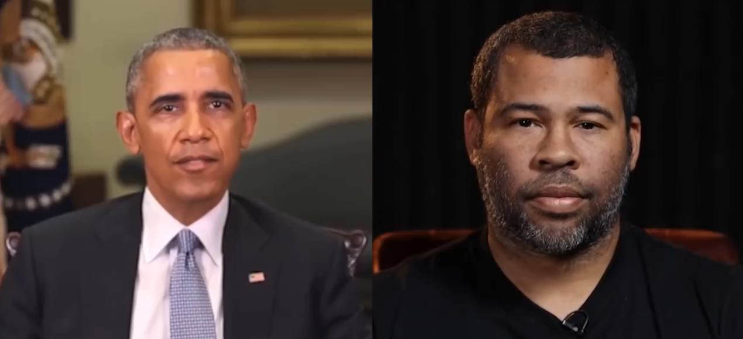
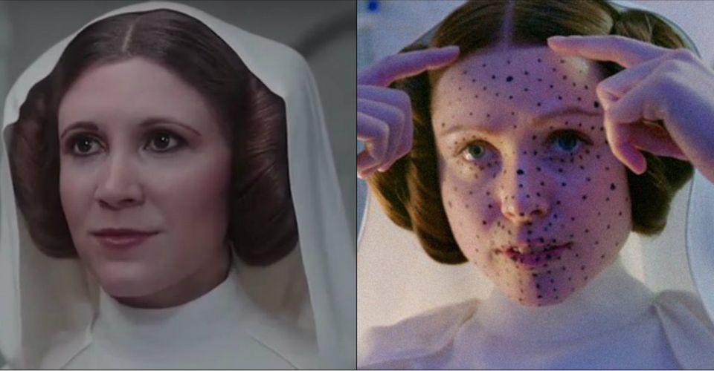
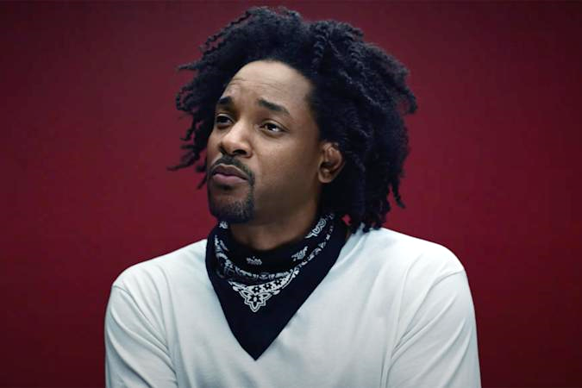
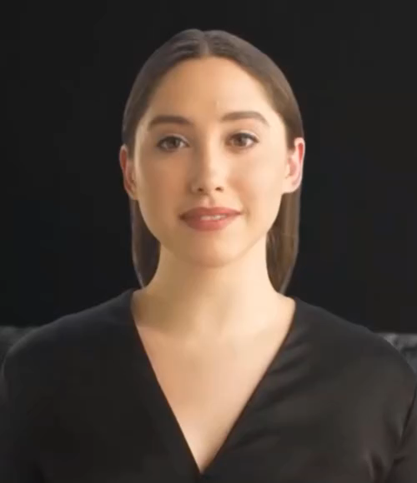

Deepfakes
“Deep Learning” + “Fake”
Deepfakes can spread dangerous misinformation
They can be used for many nefarious purposes
Detection can be hard
Kendrick or Will?
Notes:
Now we are going to dive deeper into deepfakes
Ask the students if the recognize this person
It’s actually Kendrick Lamar, but he’s wearing the deepfake “mask” of Will Smith
We will not be watching the video (The Heart Part 5) because it’s DEFINITELY not appropriate for this camp, but it’s culturally relevant
This is possible via “Deepfake” technology – portmanteau of “deep learning” and “fake”
There are several other legitimate examples, like young Carrie Fisher in Rogue One
There is also a platform named Synthesia that generates 100% A.I.-based people for use in business videos, and potentially other media
Play the video, and explain that it’s not a real person, or a real voice!
However, it’s not all good… show the video of “Obama” saying that we need to be vigilant on the internet
Then, reveal Jordan Peele and play the video again – showing that it was fabricated
Explain that deepfakes can spread dangerous misinformation – think about political figures being manipulated in that way
There are many nefarious purposes for deepfakes, mainly involving fraud
As the technology improves, it becomes more and more difficult to detect deepfakes
Companies like Twitter are working on tagging synthetic videos and making sure no one is misled
Ask the students if they can think of ways deepfakes could be used, for good or bad
https://www.youtube.com/watch?v=fM2pqqfukNc

Slide 18
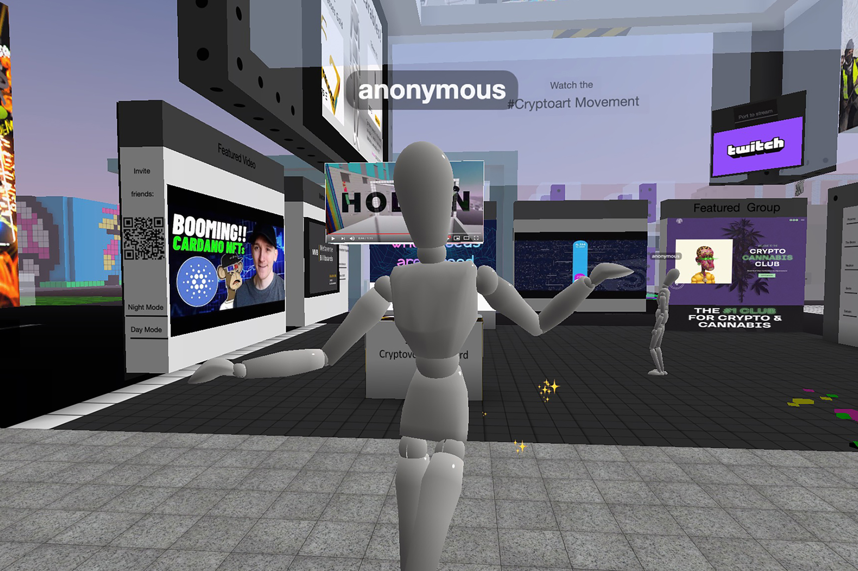

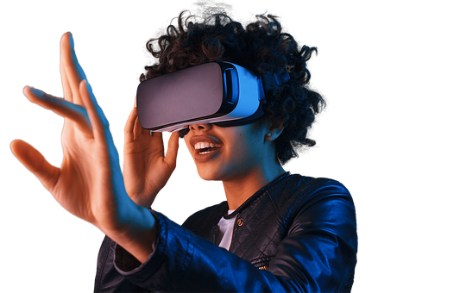
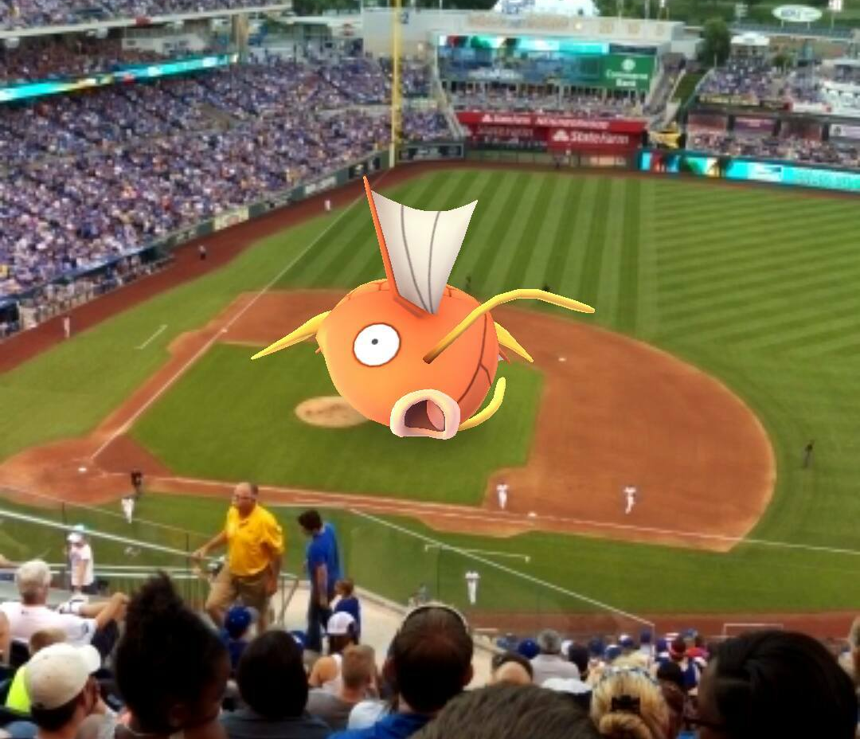
Extended Reality (XR)
Virtual Reality
Augmented Reality
Metaverse
Is virtual real estate a good investment?
Notes:
On the topic of reality, let’s get into another area of technology – extended reality (e.g. non-reality reality)
Ask the students if they know what VR stands for, and if they have examples of VR Headsets. It stands for Virtual Reality
Oculus Quest, HTC Vive, Google Cardboard
VR is fully immersive, and is meant to take the user into another world
VR is largely used for entertainment, but can also be used for education/training, healthcare, and more
Ask the students if they know what AR stands for. It stands for Augmented Reality
In Augmented Reality, a layer of non-reality is added to normal reality – an example is Pokemon Go
Ask the students if they have any ideas how AR could be used
Outside of gaming, there are applications in art, commerce, architecture, and more
Ask the students if they’ve heard of the metaverse
The term actually originated in a 1992 novel by Neal Stephenson called Snow Crash – it’s a portmanteau of “meta” and “universe”
The “metaverse” is a universal immersive virtual world, facilitated by the use of VR and AR
Recently, the idea of Blockchain and NFTs (Web3) have been incorporated into the metaverse – digital ownership is an important concept
“Virtual Land” in the metaverse is selling for hundreds of thousands of dollars right now
Poll the students with this question: “Is virtual real estate a good investment?” (1 for yes, 2 for no, 3 for maybe/not sure)

Slide 19
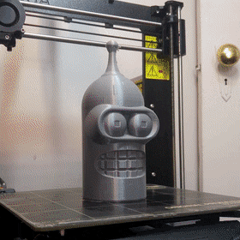

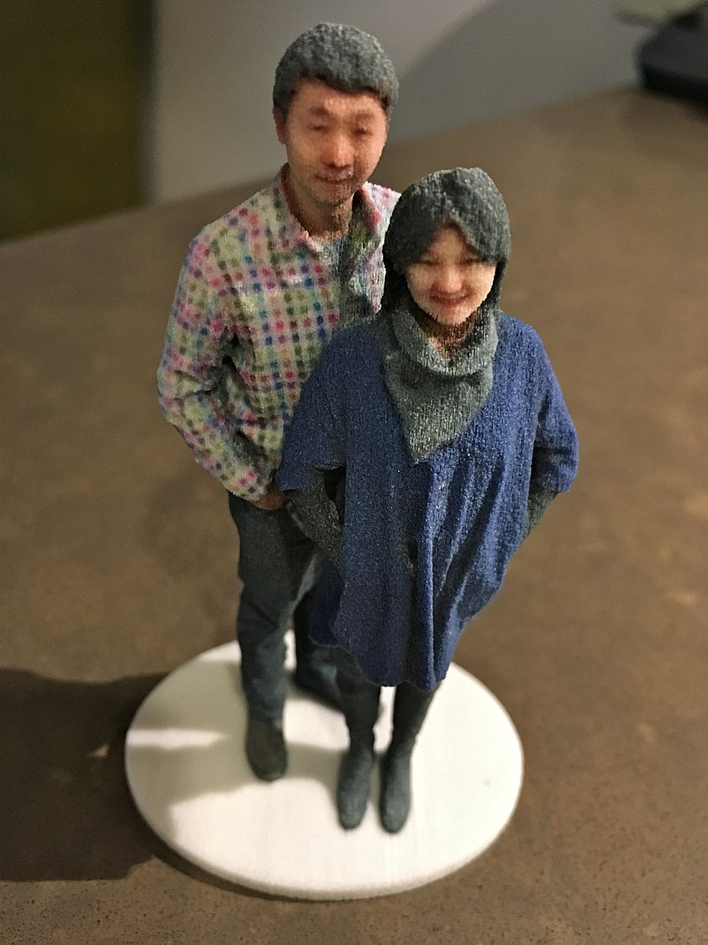
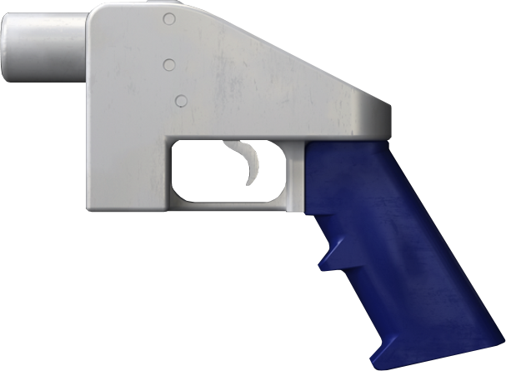
3D Printing
What can be printed?
D&D miniatures
Car parts
Prosthetics
Selfies
Architecture
3D Printers
Notes:
Now let’s shift gears from the virtual to the real – computers can make things beyond the digital world!
Show the example – ask the students if they recognize this robot (Bender from Futurama)
3D printing is the construction of a physical object from a digital model – usually plastics, but other materials can also be used (like chocolate)
Ask the students for some ideas of what they could 3D print
There is a list of some of the things that can be printed – but there’s definitely more than that!
Ask the students if they can think of any potentially ethical issues with 3D printing
One danger: it is possible to print firearms. Ask the students why that might be a bad thing
People could essentially “download” guns – with no government authorization

Slide 20
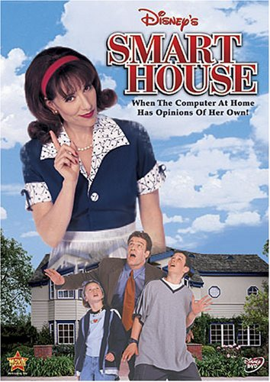
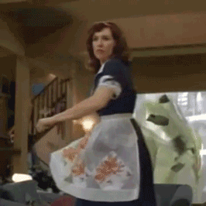
Smart Devices - IoT
Would you want to live in a smart house?
IoT (the Internet of Things) – a network of “smart” devices that connect with each other or the internet. Devices like…
Smart doorbells, locks, TVs, lights, fridges...
What could go wrong?
security, privacy, control
Notes:
Poll the students: Would you want to live in a Smart House like from the DCOM?
Basically, a house where everything is controlled by a computer connected to the internet and is running software
In the 1999 when this was released, a “Smart House” was far from reality… but now it’s not too far off
So what is the Internet of Things? Well, it’s basically a smart house – a network of “things” (aka smart devices) that are capable of running software, and connecting to the internet (or each other)
Ask the students for examples of “smart” devices
Reveal a few examples of smart devices
Ask the students for some potential concerns with smart devices
Reveal some potential concerns
General security – there is extra vulnerability – compromising one device could compromise an entire network
Privacy – companies (cough cough Amazon) could take data about your home or living habits, and use it to sell you things
Control – if someone else hacked your system, they could make things very bad (e.g. locking doors, turning up the heat, etc)
Also, your house might gain sentience, assume a corporeal form, and wreak havoc on your family

Slide 21
Computers in the
Future
How will computers impact us tomorrow?
Notes:
Now we’ve seen a few examples of current technology, and how it has affected society… let’s start to think about where that technology (or new technology entirely) could take us in the future

Slide 22
Types of Technologies
Future
Emerging
Must exist in some way
Must not be “mainstream”
Phases: research, prototype, development, diffusion
Hypothetical
Must not exist at all
Often the subject of science fiction books/movies
Might exist in the future
Examples
self-driving car | VR/AR | androids
brain-computer interface
Examples
time machine | teleporter
water-fueled car | immortality
Notes:
Let’s start by talking about two distinct types of futuristic technologies
The first is “emerging” – ask the students if they can guess what “emerging” technologies are
There are a few key criteria…
They must actually exist in some way
They must not be “mainstream” – not used by everyone already, like a smart phone or something like that
There are some basic phases:
Research (preliminary stage)
Prototype (actually having some version of the technology)
Development (active work on the technology)
Diffusion (technology works, and is in the process of becoming mainstream)
Ask the students if they can think of examples of “emerging” technologies
(hint: we have covered some of them in this presentation!)
Reveal some examples – some of these are farther along than others, but they are all considered “emerging”
Next, talk about another type of future technology – “hypothetical” – ask the students if they can guess what hypothetical technologies would be
The main criteria here is that the technology must NOT EXIST at all
These technologies are often used in Sci-Fi… but as we know, sci-fi can sometimes turn into sci-non-fi
The fun part is that these technologies might exist in the future
Ask the students if they can think of any examples of hypothetical technologies
Reveal a few examples – time machines and teleporters will probably never exist, but water-fueled cars and immortality via life extension may be possible
Or, who knows, anything might happen or not happen

Slide 23
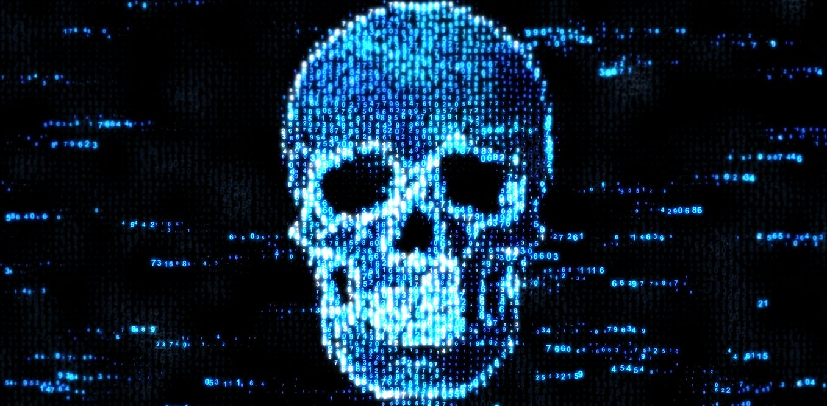
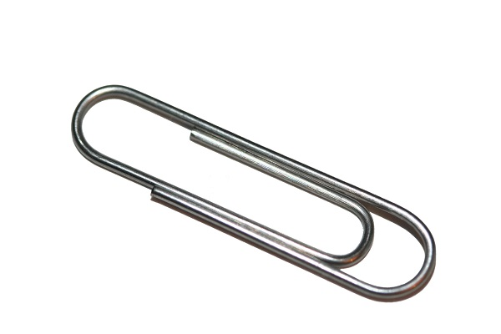
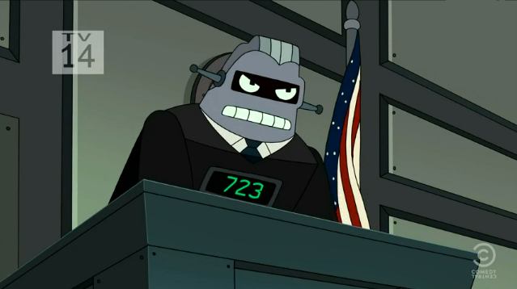

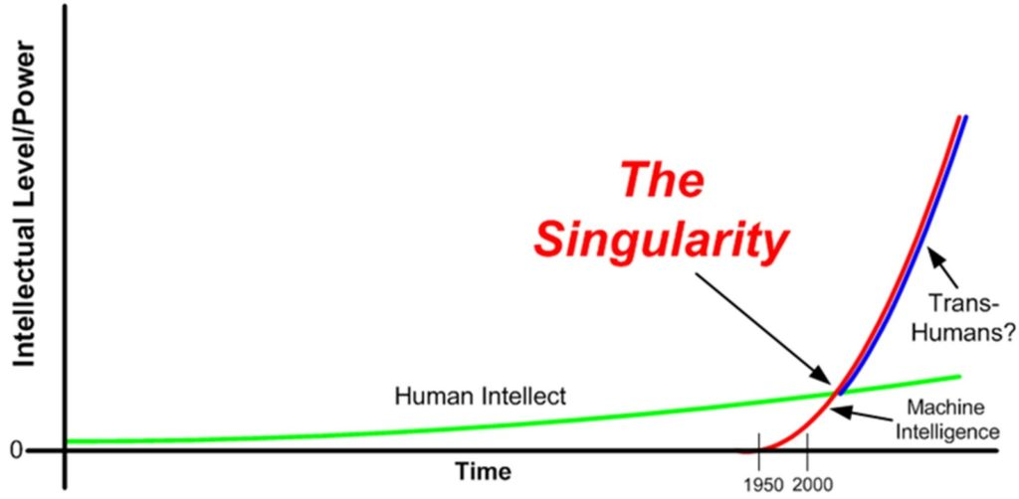
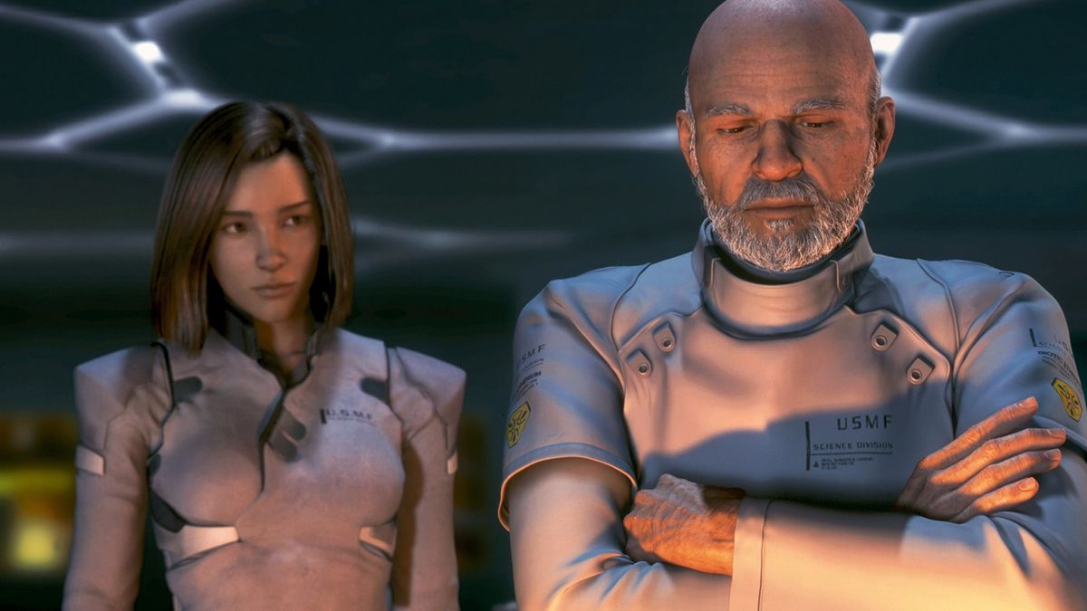
The
Future
of A.I.
How might artificial intelligence impact the future?
Government by Algorithm
Intelligence Explosion
When technological growth becomes uncontrollable and humanity changes forever
Fully A.I.-Generated Films
Notes:
Now let’s dive into some of these future technologies. We’ll start with an emerging one – artificial intelligence
Ask the students if they have any ideas for how A.I. could impact the future
One example – government by algorithm – there have been some real-world examples of AI getting involved in politics
In Japan, an artificial intelligence ran for public office
In the 80s, there was a software called “Split Up” that handled divorce proceedings, and split up estates
Poll the students: would you like to be governed by an artificial intelligence?
Another potential future would be deepfake films
The A.I. could generate the visuals, the audio/dialog… could even write the story!
Poll the students: do you think a fully A.I.-generated movie would be good?
Now for a less realistic idea – Ask the students if they’ve heard of the “singularity”
This is a hypothetical point in time at which technological growth becomes uncontrollable and irreversible, resulting in unforeseeable changes to human civilization.
This could cause an “intelligence explosion” – basically, if an Artificial General Intelligence is capable of improving itself, there’s nothing stopping it from continuous improvement… which makes it get faster and faster and better and better at an accelerated pace
This could lead to a superintelligence – something humans could not even comprehend, way beyond any human intelligence
One fun thought experiment is a paperclip maximizer – say a superintelligence had a goal of creating paperclips. It might neglect all other responsibilities and simply optimize its ability to create paperclips – thus destroying the universe.
Poll the students: Will a technological singularity happen?
https://en.wikipedia.org/wiki/Split_Up_(expert_system)
https://mitpress.mit.edu/books/technological-singularity
https://www.lesswrong.com/tag/paperclip-maximizer

Slide 24
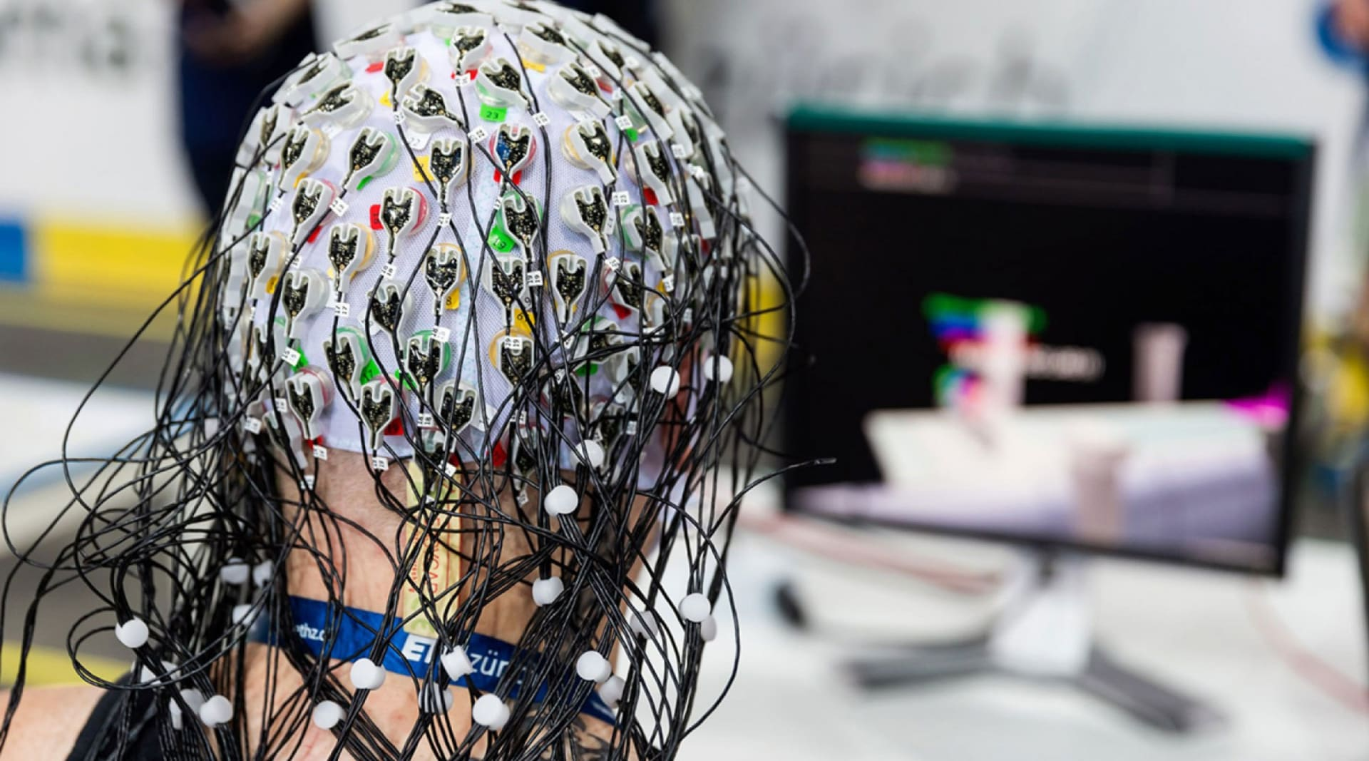
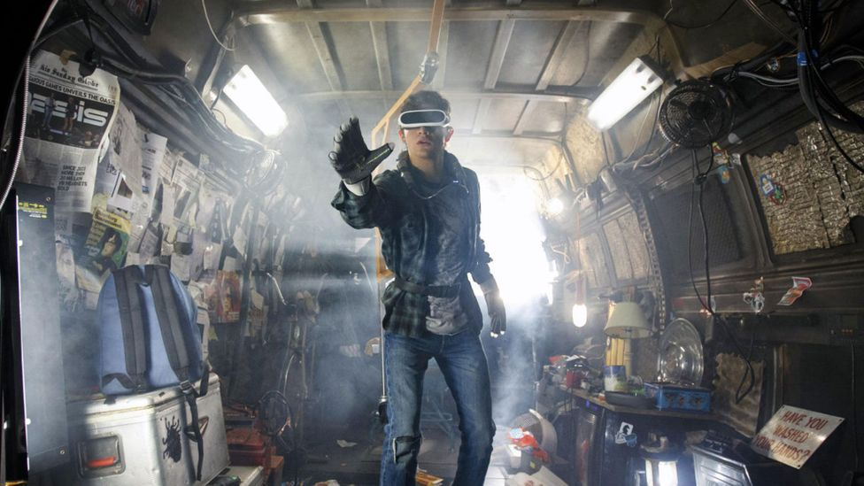
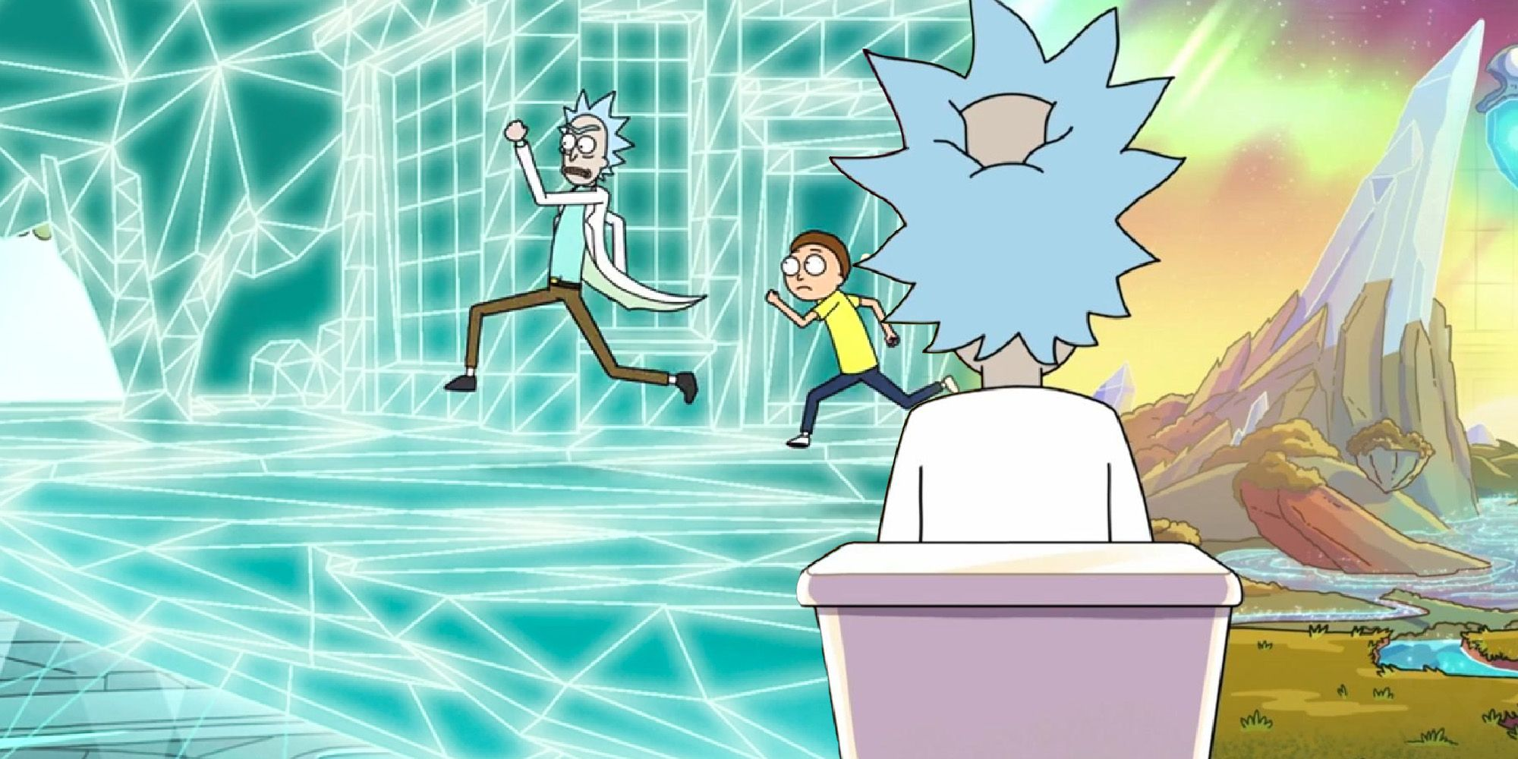

The
Future
of Extended Reality
How might extended reality (VR/AR/etc) impact the future?
Virtual Society
Brain-Computer Interface
Are we living in a simulation?
Does it matter?
Notes:
Let’s talk about another emerging technology – extended reality
Ask the students if they have ideas about how Extended Reality could impact the future
One possibility is a complete virtual society – like in Ready Player One
People might spend more time in VR than they do in real life
Entire economies, cultures, and communities could exist digitally
Another possibility, that may be a little more out there – Brain-Computer Interfaces mostly exist for prosthetic limbs – being able to read impulses from the brain
But what if it were possible to use a brain-computer interface to completely stimulate a person’s perception?
If that’s possible, extended reality might become so advanced that it is completely indistinguishable from our reality…
Poll the students: Are we currently living in a simulation?
Follow-up question: does it matter if we’re in a simulation?
http://consc.net/reality+/excerpt.pdf

Slide 25

Quantum Computing
Quantum computing is an emerging technology that harnesses the properties of quantum physics to perform calculations
Quantum algorithms use these features to run much faster – e.g., Shor’s Algorithm
The speed could lead to much more efficient artificial intelligence training or world simulation – but it’s a long way off
Notes:
No need to spend too long on this slide…
Let’s talk about quantum computing briefly – I mainly put this here because quantum computers look so cool
Go over the definition – no need to go too deep, just touch on the fact that quantum computers use weird stuff in quantum physics
Quantum algorithms are just algorithms that use quantum computing – for example, Shor’s Algorithm – that could potentially break cryptography (meaning someone could hack pretty much anything on the internet)
Sum this up by mentioning that the speed of these computers could drastically increase the efficiency of things like AI or world simulation – but the technology is still a long way from that.

Slide 26




More Topics – Hypothetical
Molecular Nanocomputers
Really tiny computers capable of working at the atomic level
Santa Claus Machine
Von Neumann Probe
Whole-Brain Emulation
Scanning a physical human brain and recreating it entirely in a digital form
Mind Uploading
Thought Recording
Notes:
The point of this slide is simply to throw out a lot of ideas for things that could exist in the future – their feasibility is definitely in question
One big area that could lead to a lot of interesting developments is molecular computers – read the definition
These nanocomputers could be used to create something like a Santa Claus Machine
This machine could take in any form of matter (rocks, dirt, etc), rearrange the molecules, and create any other object
Taking that a step further, there is the Von Neumann Probe (pronounced NOY-man) – a self-replicating spacecraft
These probes could explore the far reaches of the galaxy, landing on planets, harvesting resources, and rebuilding themselves
Poll the students: Do you think a Santa Claus Machine could ever actually exist?
Another interesting topic is whole-brain emulation – the idea of taking a human brain and representing it in a digital form
One thing that could arise from that would be mind uploading
Like the San Junipero episode of Black Mirror, this could lead to digital immortality
Another potential application would be thought recording
If you can represent a brain, you can represent experience, and maybe even share your experience with others… what would the consequences be?
Poll the students: Would an “uploaded” mind be conscious?

Slide 27
Summary
Wrapping things up
Notes:
Well, at this point, a lot of different topics have been covered, and hopefully they’ve made you think a little bit. Let’s go over everything we discussed

Slide 28
Summary
Past
Primitive computers, A.I., the internet, and other digital technology has impacted our culture, economy, and society
Present
Current computer technologies like smart phones, A.I., blockchain, VR, and more continue to impact society
Your Impact
As a member of Gen Z (aka a Zoomer), you will have the opportunity to work with new technologies and shape the future of our world
Future
Emerging technologies and hypothetical technologies will have an impact on society as they evolve
Notes:
Go through a brief summary of the presentation
Talk about how computers have impacted society in the past
Ask the students for examples
Ask the students for a take-away about computers in the past
Talk about how computers currently impact society
Ask the students for examples
Ask the students for a take-away about computers in the present
Talk about how computers and new tech will impact society in the future
Ask the students for examples
Ask the students for a take-away about computers in the future
Emphasize that the students themselves will be the ones who will really have the opportunity to work with these new technologies - their generation will be the one that has the biggest impact

Slide 29
THANK YOU!
WHAT QUESTIONS DO YOU HAVE?
Hyland Hy-Tech Camp

